Slide 1
Images

Slide 2
Basics of images
Two basic image types
Vector - svg, ps …
Raster - jpeg, png
Basic difference, vector graphics are a set of instructions for recreating the image, raster images are an array
Generally raster images are the more convenient format for image data science work
Raster images are often compressed
For example, our autoencoder was a compression algorithm
Internal storage is more complex for compressed images but working with them is the same since the software for loading them decompress the images

Slide 3
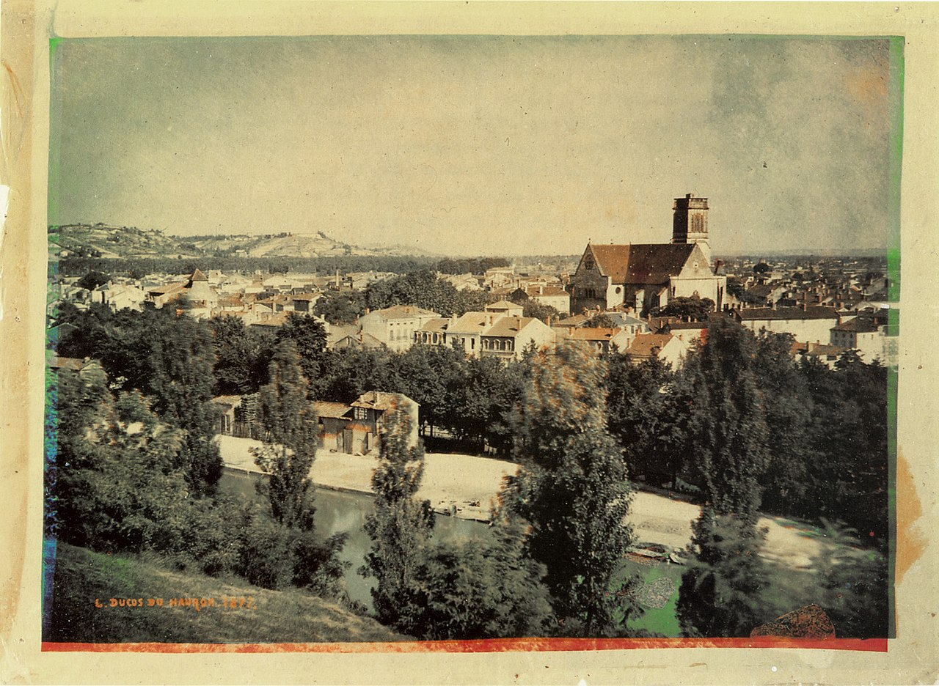
Channels
Gray scale images are a matrix where pixels are organized in a grid (rows and columns)
Color images are represented as several color channels
Each color channel is itself a matrix of pixel values
Our displays then show the channels simultaneously so that the image appears color
More than one color representation format exists
RGB (red green blue)
CMYK (cyan, magenta, yellow, black)

Slide 4
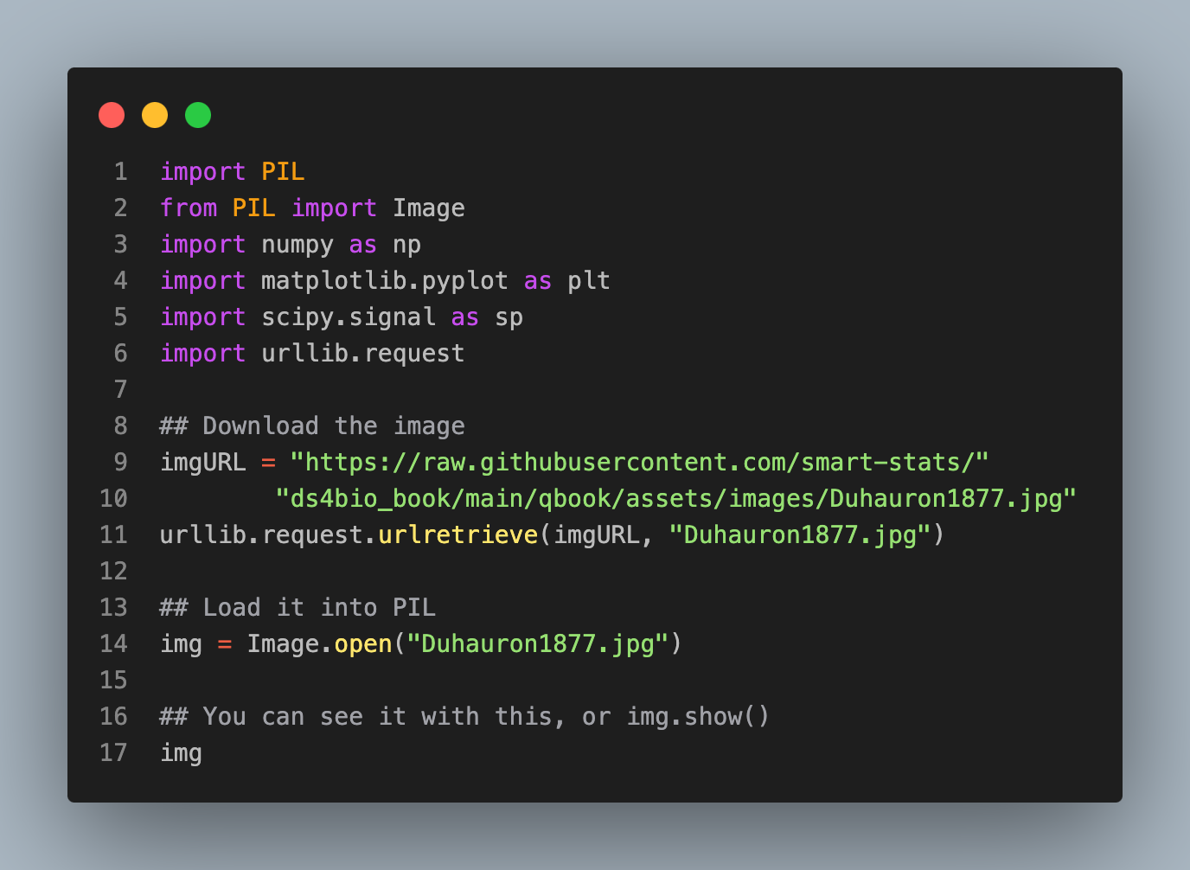
Working with images in python

Slide 5
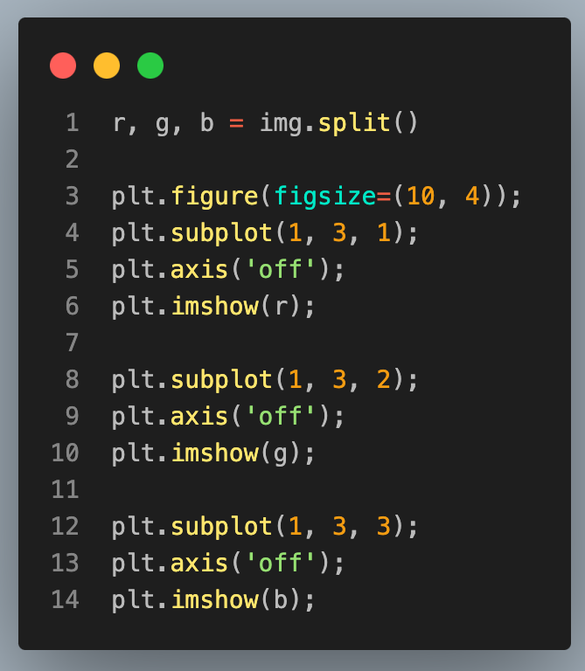
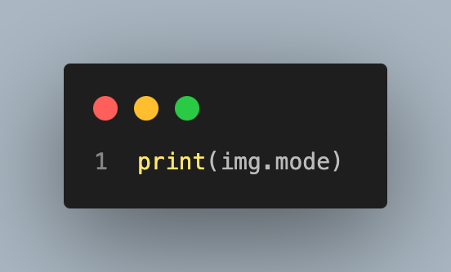
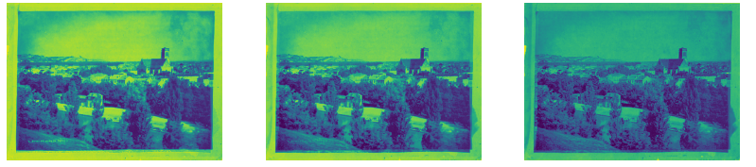
Image mode, plotting channels
RGB

Slide 6
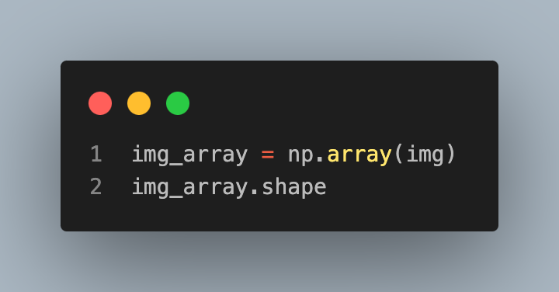
Getting the image into a numpy array
(585, 800, 3)

Slide 7
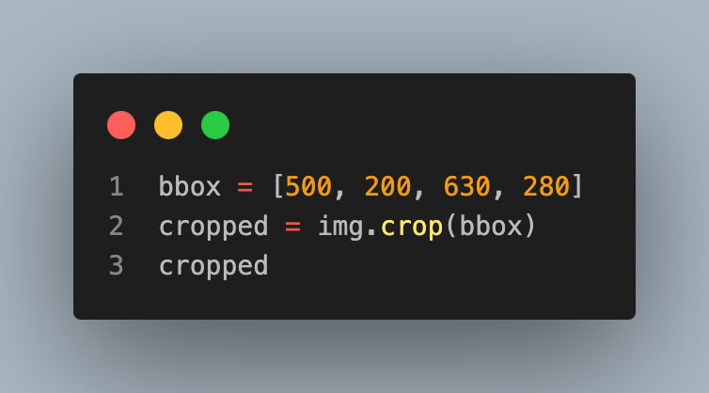
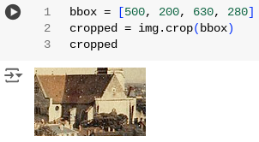
Example of working with images using PIL, cropping

Slide 8
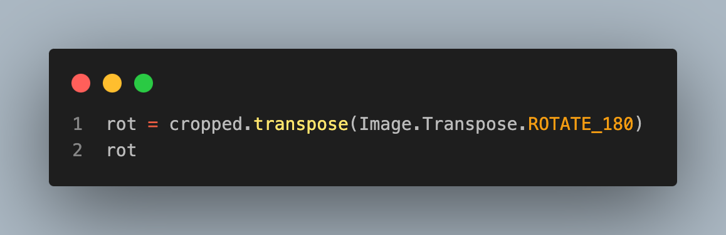
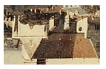
Working with images, rotating

Slide 9
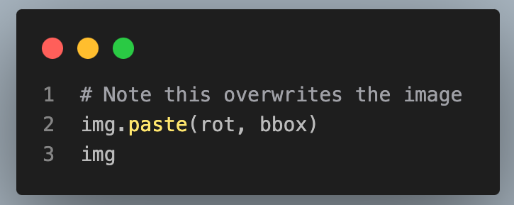
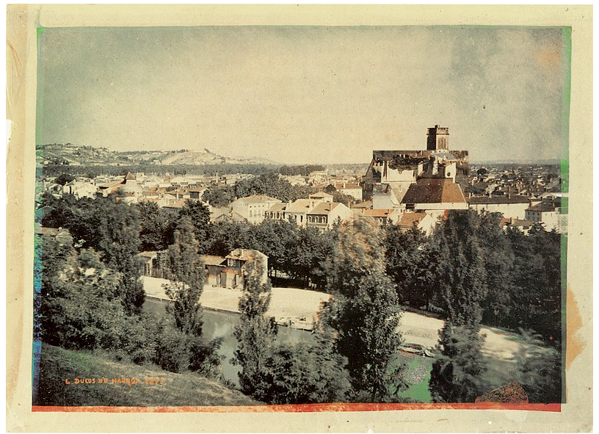
Working with images, overlaying

